Slide 1
Apache Spark’s Performance Project Tungsten and Beyond
Sameer Agarwal
Spark Summit| Brussels| Oct 26th 2016

Slide 2
About Me
Software Engineer at Databricks (Spark Core/SQL)
PhD in Databases (AMPLab, UC Berkeley)
Research on BlinkDB (Approximate Queries in Spark)

Slide 3
Hardware Trends
Storage
Network
CPU

Slide 4
Hardware Trends
 | 2010
Storage | 50+MB/s (HDD)
Network | 1Gbps
CPU | ~3GHz

Slide 5
Hardware Trends
 | 2010 | 2016
Storage | 50+MB/s (HDD) | 500+MB/s (SSD)
Network | 1Gbps | 10Gbps
CPU | ~3GHz | ~3GHz

Slide 6
Hardware Trends
 | 2010 | 2016
Storage | 50+MB/s (HDD) | 500+MB/s (SSD) | 10X
Network | 1Gbps | 10Gbps | 10X
CPU | ~3GHz | ~3GHz | ☹

Slide 7
On the flip side
Spark IO has been optimized
Reduce IO by pruning input data that is not needed
New shuffle and network implementations (2014 sort record)
Data formats have improved
E.g. Parquet is a “dense” columnar format
CPU increasingly the bottleneck; trend expected to continue

Slide 8
Goals of Project Tungsten
Substantially improve the memory and CPU efficiency of Spark backend execution and push performance closer to the limits of modern hardware.
Note the focus on “execution” not “optimizer”: relatively easy to pick broadcast hash join that is 1000X faster than Cartesian join, but hard to optimize broadcast join to be an order of magnitude faster.

Slide 9
Phase 1
Foundation
Memory Management
Code Generation
Cache-aware Algorithms
Phase 2
Order-of-magnitude Faster
Whole-stage Codegen
Vectorization

Slide 10
Phase 1 Laying The Foundation

Slide 11
Summary
Perform explicit memory management instead of relying on Java objects
Reduce memory footprint
Eliminate garbage collection overheads
Use sun.misc.unsafe rows and off heap memory
Code generation for expression evaluation
Reduce virtual function calls and interpretation overhead
Cache conscious sorting
Reduce bad memory access patterns

Slide 12
Phase 2 Order-of-magnitude Faster

Slide 13
Going back to the fundamentals
Difficult to get order of magnitude performance speed ups with profiling techniques
For 10x improvement, would need of find top hotspots that add up to 90% and make them instantaneous
For 100x, 99%
Instead, look bottom up, how fast should it run?

Slide 14
Aggregate
select count(*) from store_sales where ss_item_sk = 1000
Project
Filter
Scan

Slide 15
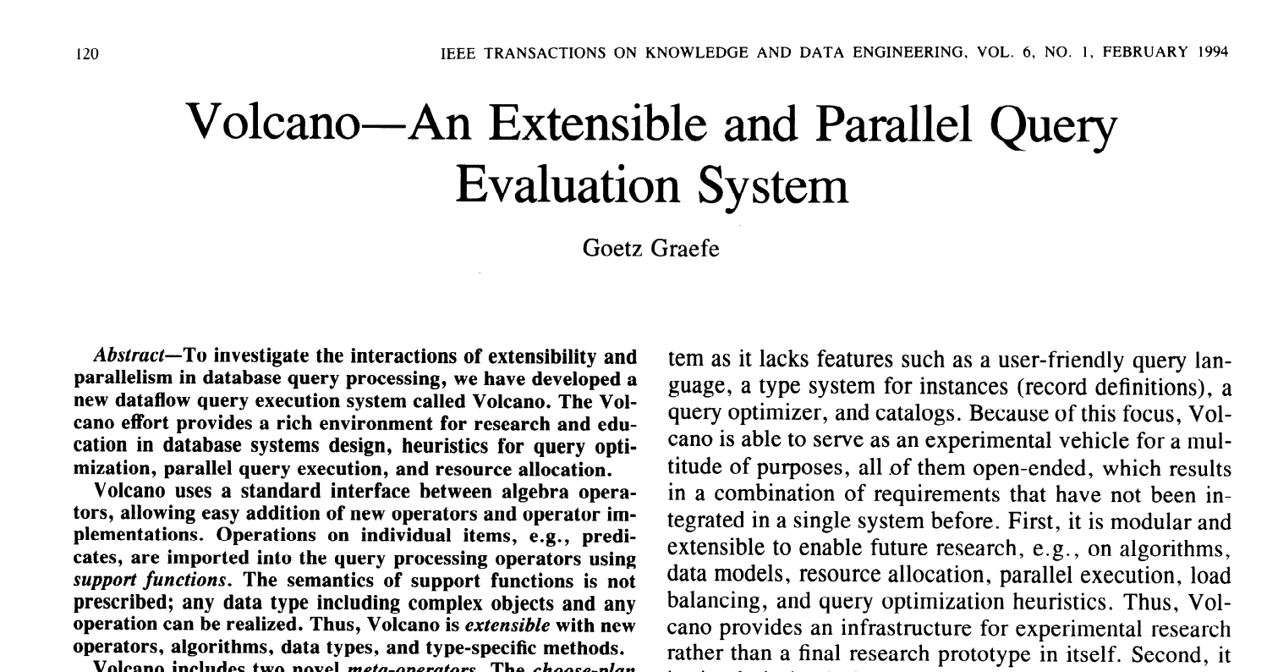
G. Graefe, Volcano— An Extensible and Parallel Query Evaluation System,
In IEEE Transactions on Knowledge and Data Engineering 1994

Slide 16
Volcano Iterator Model
Standard for 30 years: almost all databases do it
Each operator is an “iterator” that consumes records from its input operator
class Filter(
child: Operator,
predicate: (Row => Boolean))
extends Operator {
def next(): Row = {
var current = child.next()
while (current == null ||predicate(current)) {
current = child.next()
}
return current
}
}

Slide 17
What if we hire a college freshman to implement this query in Java in 10 mins?
select count(*) from store_sales where ss_item_sk = 1000
long count = 0;
for (ss_item_sk in store_sales) {
if (ss_item_sk == 1000) {
count += 1;
}
}

Slide 18
Volcano model
30+ years of database research
college freshman
hand-written code in 10 mins
vs

Slide 19
Volcano
13.95 million
rows/sec
college
freshman
125 million
rows/sec
High throughput
Note: End-to-end, single thread, single column, and data originated in Parquet on disk

Slide 20
How does a student beat 30 years of research?
Volcano Model
Hand-written code
Too many virtual function calls
Intermediate data in memory (or L1/L2/L3 cache)
Can’t take advantage of modern CPU features -- no loop unrolling, SIMD, pipelining, prefetching, branch prediction etc.
No virtual function calls
Data in CPU registers
Compiler loop unrolling, SIMD, pipelining
Take advantage of all the information that is known after query compilation

Slide 21
Whole-stage Codegen
Fusing operators together so the generated code looks like hand optimized code:
Identify chains of operators (“stages”)
Compile each stage into a single function
Functionality of a general purpose execution engine; performance as if hand built system just to run your query

Slide 22
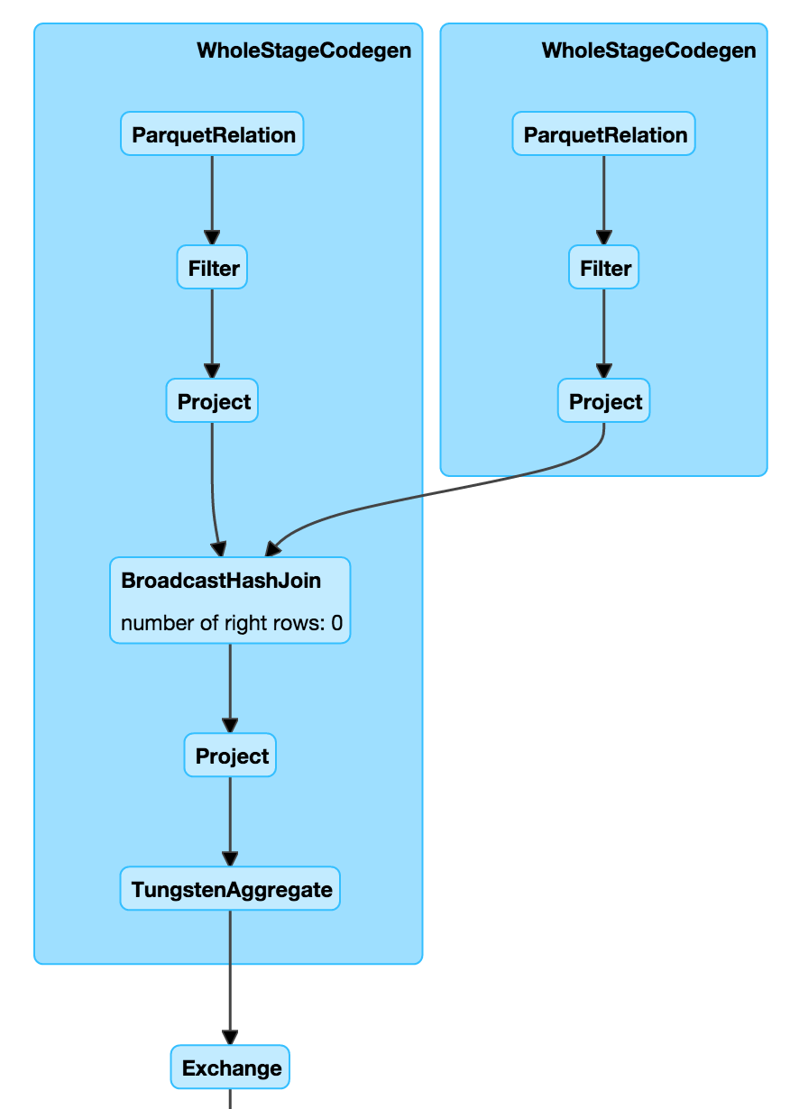
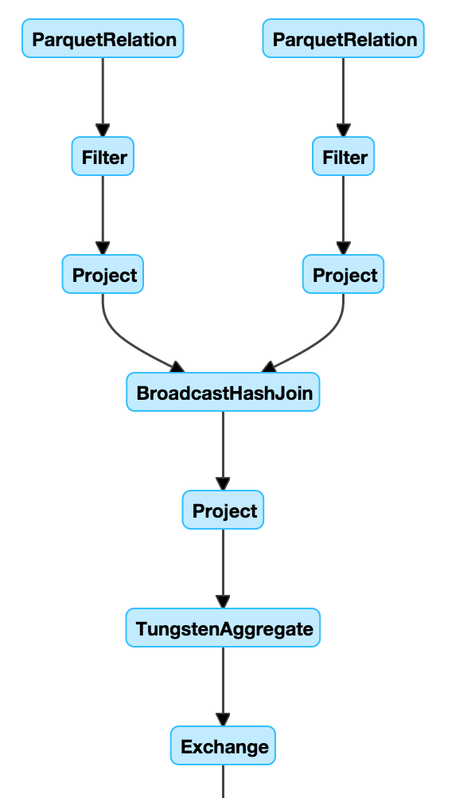
Whole-stage Codegen: Planner

Slide 23
Whole-stage Codegen: Spark as a “Compiler”
Aggregate
long count = 0;
for (ss_item_sk in store_sales) {
if (ss_item_sk == 1000) {
count += 1;
}
}
Project
Filter
Scan

Slide 24
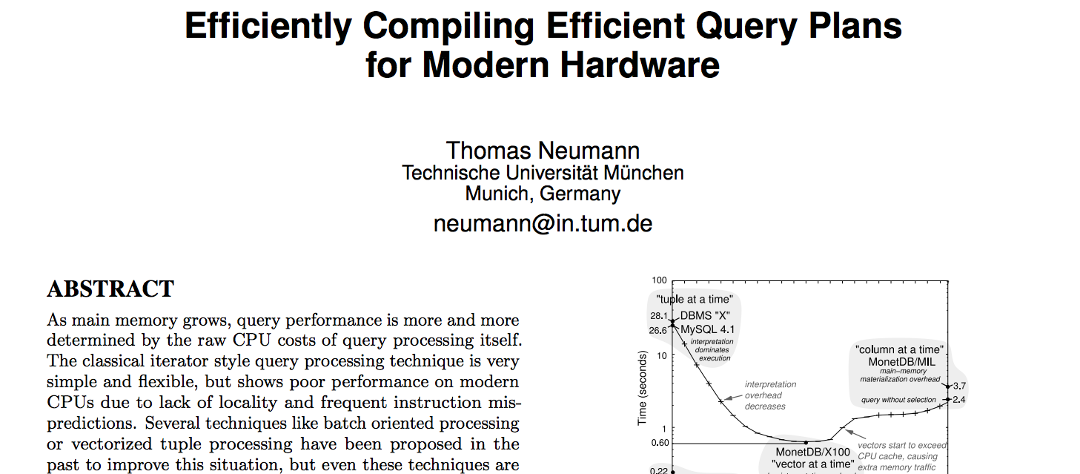
T Neumann, Efficiently compiling efficient query plans for modern hardware. In VLDB 2011

Slide 25
But there are things we can’t fuse
Complicated I/O
CSV, Parquet, ORC, …
Sending across the network
External integrations
Python, R, scikit-learn, TensorFlow, etc

Slide 26
Columnar in memory format
In-memory
Row Format
In-memory
Column Format
1
john
4.1
1
2
3
2
mike
3.5
john
mike
sally
3
sally
6.4
4.1
3.5
6.4

Slide 27
Why columnar?
More efficient: denser storage, regular data access, easier to index into
More compatible: Most high-performance external systems are already columnar (numpy, TensorFlow, Parquet); zero serialization/copy to work with them
Easier to extend: process encoded data

Slide 28
Parquet
11 million
rows/sec
Parquet
vectorized
90 million
rows/sec
High throughput
Note: End-to-end, single thread, single column, and data originated in Parquet on disk

Slide 29
Putting it All Together

Slide 30
Demo
Phase 1
Spark 1.4 - 1.6
Memory Management
Code Generation
Cache-aware Algorithms
Phase 2
Spark 2.0+
Whole-stage Code Generation
Columnar in Memory Support
Both whole stage codegen [SPARK-12795] and the vectorized
parquet reader [SPARK-12992] are enabled by default in Spark 2.0+

Slide 31
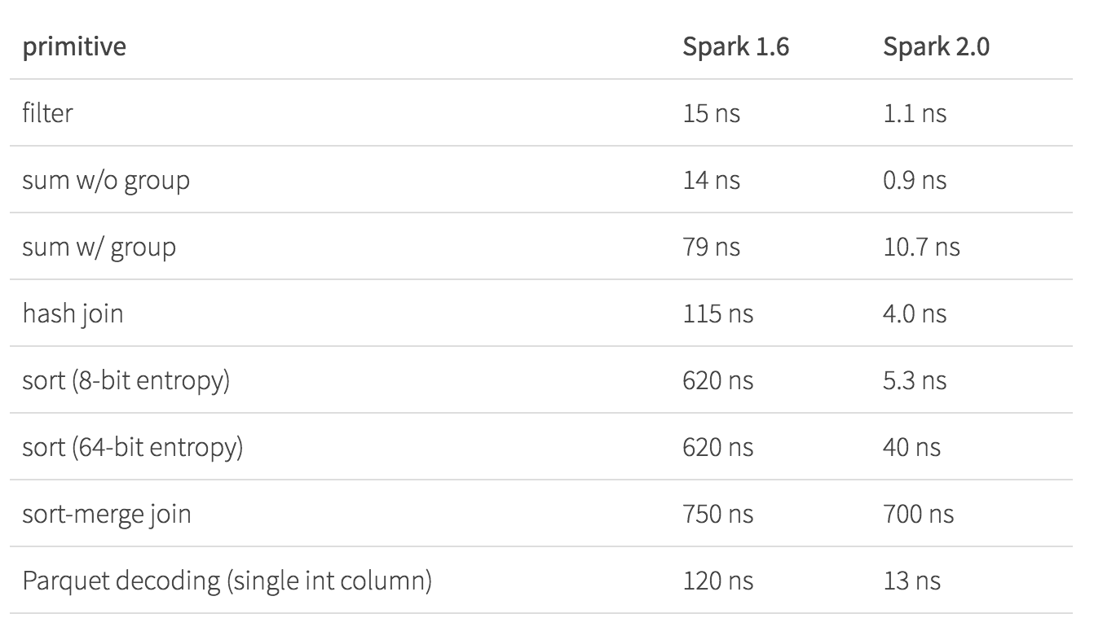
Operator Benchmarks: Cost/Row (ns)
5-30x
Speedups

Slide 32
Operator Benchmarks: Cost/Row (ns)
Radix Sort
10-100x
Speedups

Slide 33
Operator Benchmarks: Cost/Row (ns)
Shuffling
still the
bottleneck

Slide 34
Operator Benchmarks: Cost/Row (ns)
10x
Speedup

Slide 35
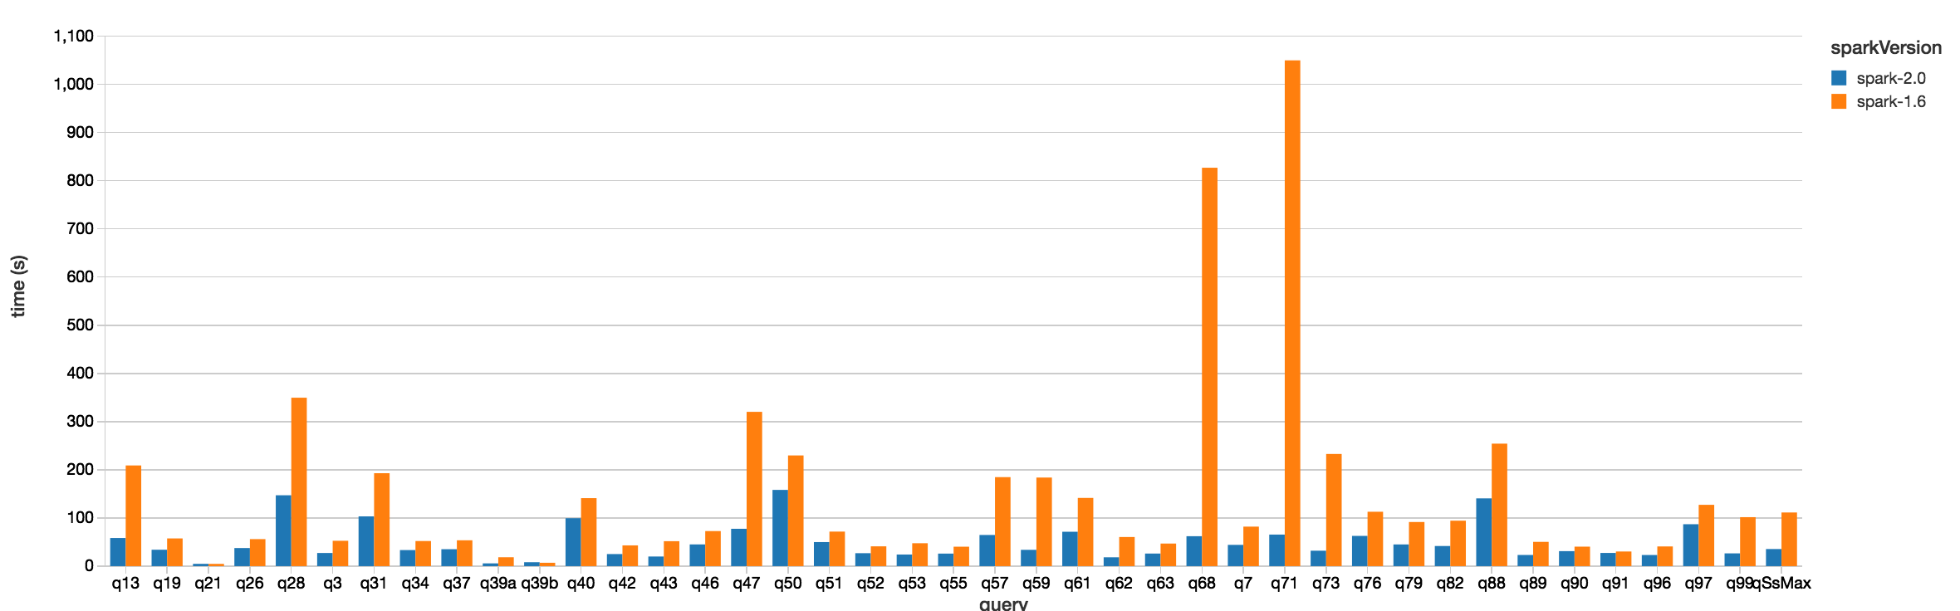
TPC-DS (Scale Factor 1500, 100 cores)
Spark 2.0
Spark 1.6
Lower is Better
Query Time
Query #

Slide 36
What’s Next?

Slide 37
Spark 2.1, 2.2 and beyond
SPARK-16026: Cost Based Optimizer
Leverage table/column level statistics to optimize joins and aggregates
Statistics Collection Framework (Spark 2.1)
Cost Based Optimizer (Spark 2.2)
Boosting Spark’s Performance on Many-Core Machines
Qifan’s Talk Today at 2:55pm (Research Track)
In-memory/ single node shuffle
Improving quality of generated code and better integration with the in-memory column format in Spark

Slide 38
Questions?
I’ll also be at the Databricks booth tomorrow from 12-2pm!

Slide 39
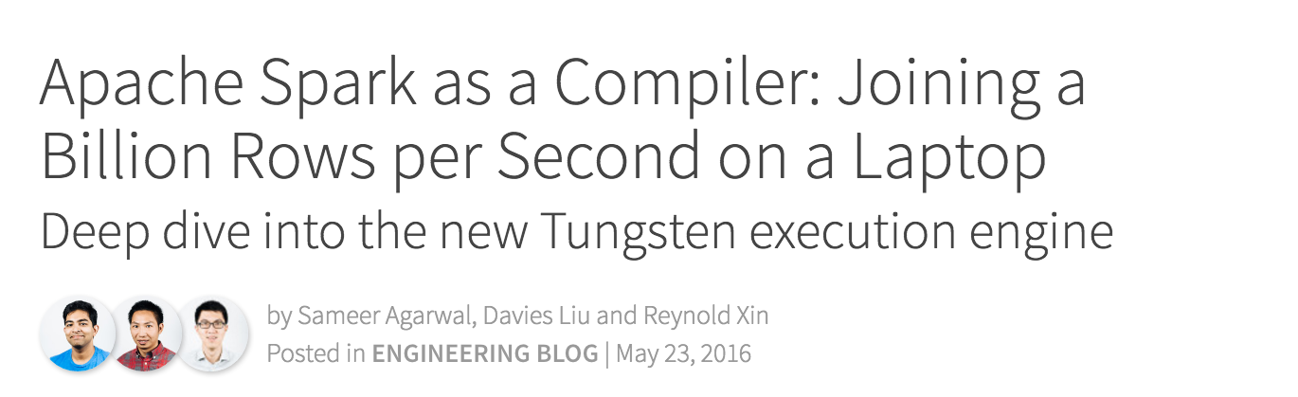
Further Reading
http://tinyurl.com/project-tungsten

